Slide 1
SOCIAL PSYCHOLOGY (Applied Social Psychology)
SESSION 11

Slide 2
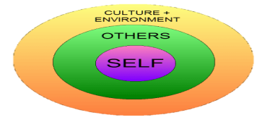
What is social psychology?
The study of how people think about, influence and relate to others, whether their presence is actual or implied - Gordon Allport
Baron, Byrne & Suls (1989) define social psychology as ....“the scientific field that seeks to understand the nature and causes of individual behavior in social situations”.
These influences are active when others are not present, we carry internal representations of others. How often have you considered carrying out an action when alone and thought “What would ______________ think?” (We imagine how someone might react to the actions we might perform)
An individuals surrounding/environment has an impact on them and the study of these influences comes under Social Psychology

Slide 3
What is social psychology NOT?
Anthropology
Cultural level of analysis
Sociology
Societal level of analysis
Personality psychology
Individual level of analysis
Social psychologists believe in “the power of the situation” and an interpersonal level of analysis. Social psychology truly does investigate the entire span of social existence

Slide 4
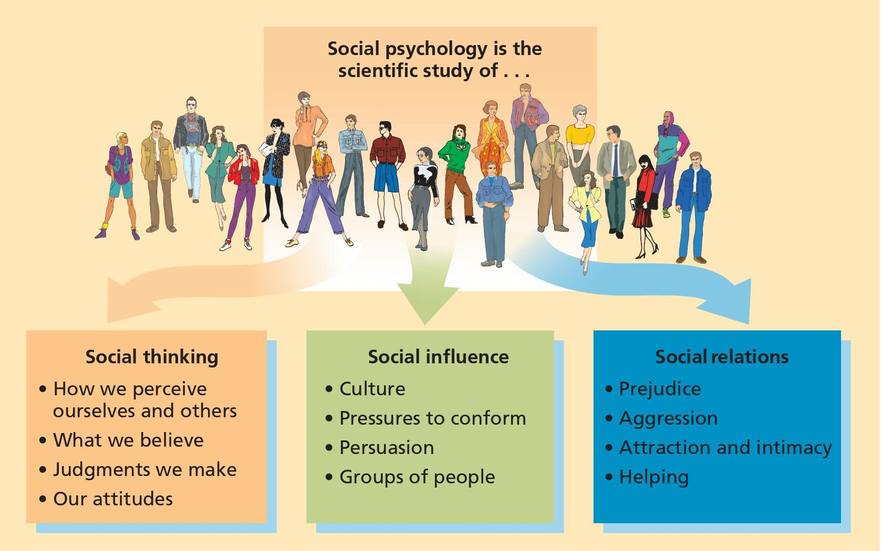
Themes in Social Psychology

Slide 5
Four major headings of Social Psychology (Baron (8-11))
Actions and Characteristics of Others: How our thoughts and behaviors are influenced by other people. E.g., someone attractive looks at you
Cognitive Processes: Perception dictates your thoughts and behaviors. E.g., someone takes your seat
Environmental Variables: Physical environment has an impact on us. E.g., summer heat and fasting
Biological Factors: Genetics play a role in behavior and thought. E.g., same situation, different reactions

Slide 6
Historical Roots of Social Psychology
First experiment in 1898 (p.4, 269) Perhaps the first social psychology laboratory experiment was undertaken in this area by Norman Triplett in 1898. In his research on the speed records of cyclists, he noticed that racing against each other rather than against the clock alone increased the cyclists' speeds. He attempted to duplicate this under laboratory conditions using children and fishing reels. There were two conditions: the child alone and children in pairs but working alone. Their task was to wind in a given amount of fishing line and Triplett reports that many children worked faster in the presence of co-actors (co-participants working individually on a noncompetitive activity) doing the same task. Triplett's experiments demonstrate social facilitation.

Slide 7
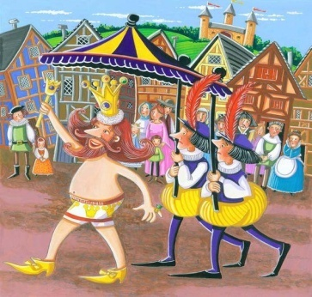
First Social psychology textbook published in 1908. Started to take form in 1930s.
Post WWII, Social Psychology emerged as a field. People started to turn to Social Psychology to understand what causes violence, prejudice, genocide, obedience, conformity and the like.
There are a few prominent figures that helped shape social psychology as a field
1) The Allport Brothers
Floyd Allport- 1930’s, gave the concept of ‘pluralistic ignorance.’ Does any know this story?
Pluralistic Ignorance- “no one believes, but everyone thinks that everyone believes.” In short, pluralistic ignorance is a bias about a social group, held by a social group.
Gordon Allport- Younger brother of Floyd Allport, conducted pioneering research on attitudes, prejudice, religion, personality etc. In 1954 he put forth the "intergroup contact hypothesis" – a theory that the more contact members of a majority group have with a minority group, the less prejudice they feel towards them.

Slide 8
‘I knew it all along’- The tendency to think that we could have predicted something that we probably would not have been able to predict, because its common sense
Major reason why we cannot rely on commonsense and have to study Social Psychology
Question:- If I am conducting a research on self-esteem and parenting, what do you think the results would look like?
Easy to predict because it is common sense knowledge?
Eg- When you miss someone, you tend to feel closer to them, realize that you have/had a special bond. This is because absence makes the heart grow fonder. Do you agree?
What about the phenomenon, out of sight out of mind?
The reason that research is needed was confirmed by a study by Karl Teigen (1986) where he did exactly the following, he gave students phrases to rate that were widely accepted alongside their opposites ->

Slide 9
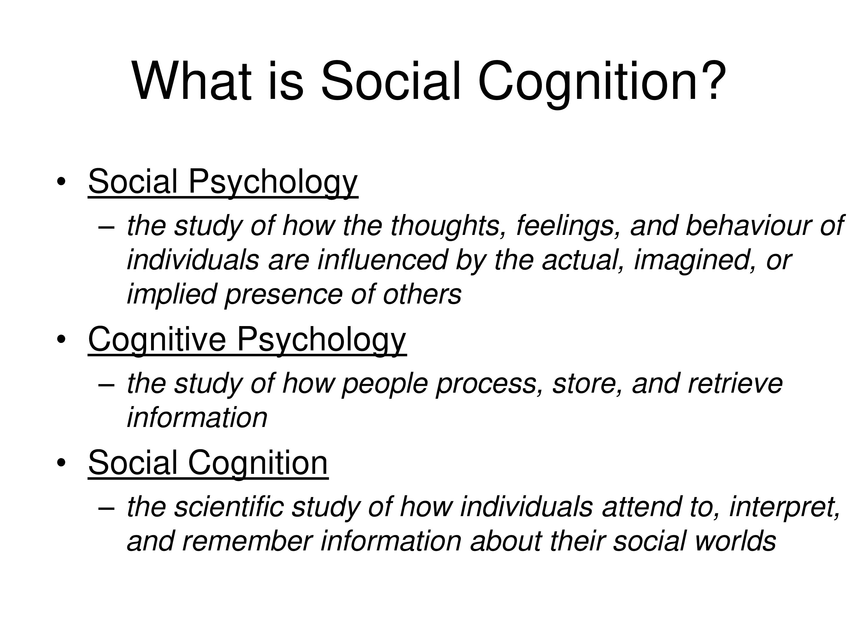

Slide 10
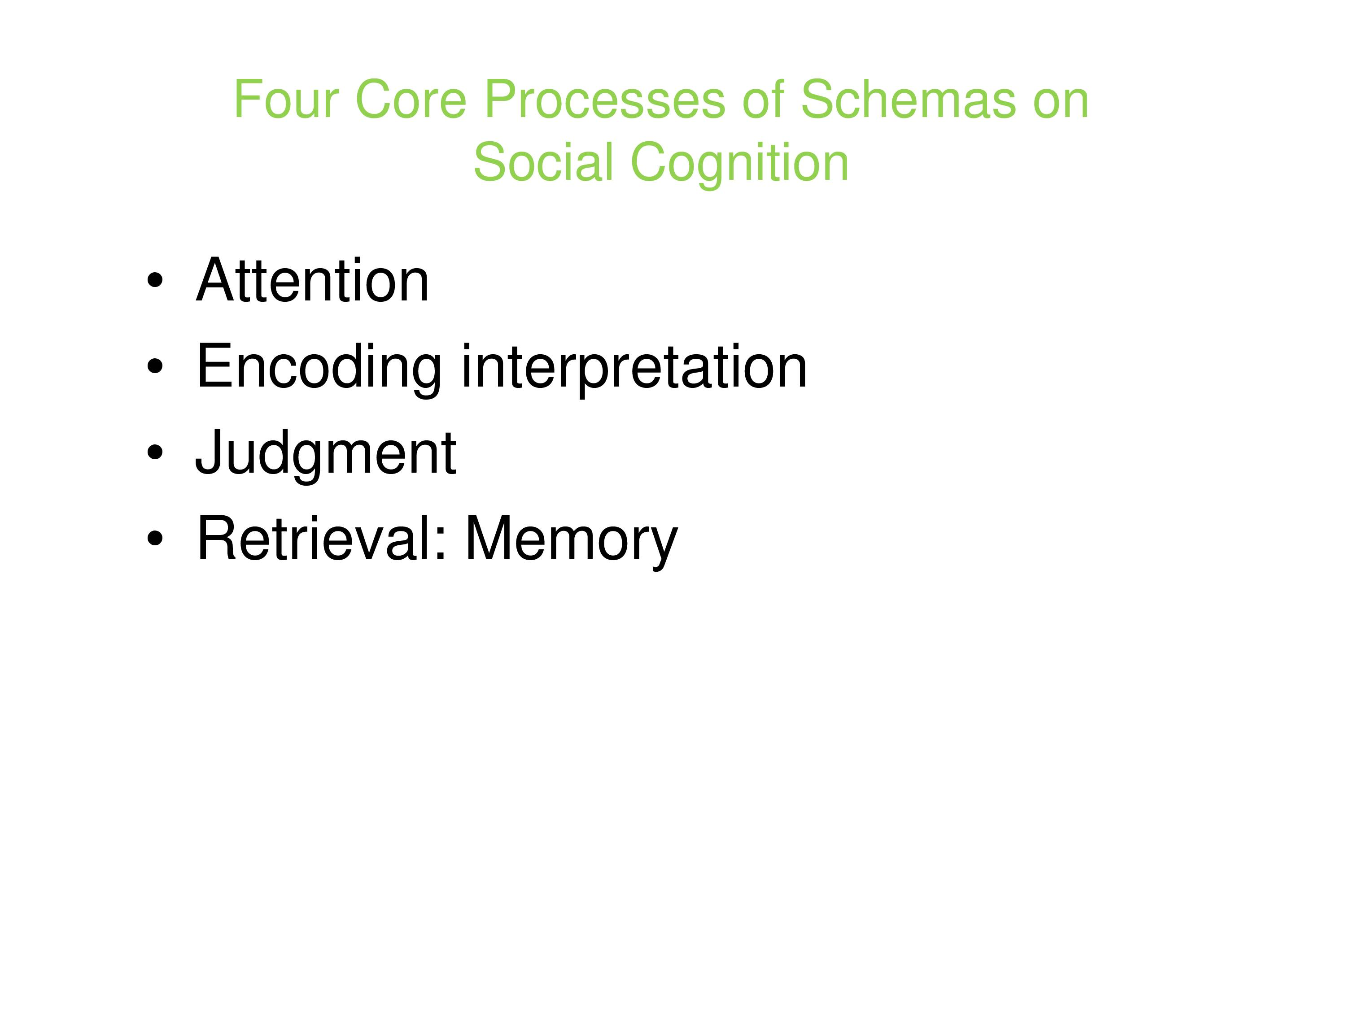

Slide 11
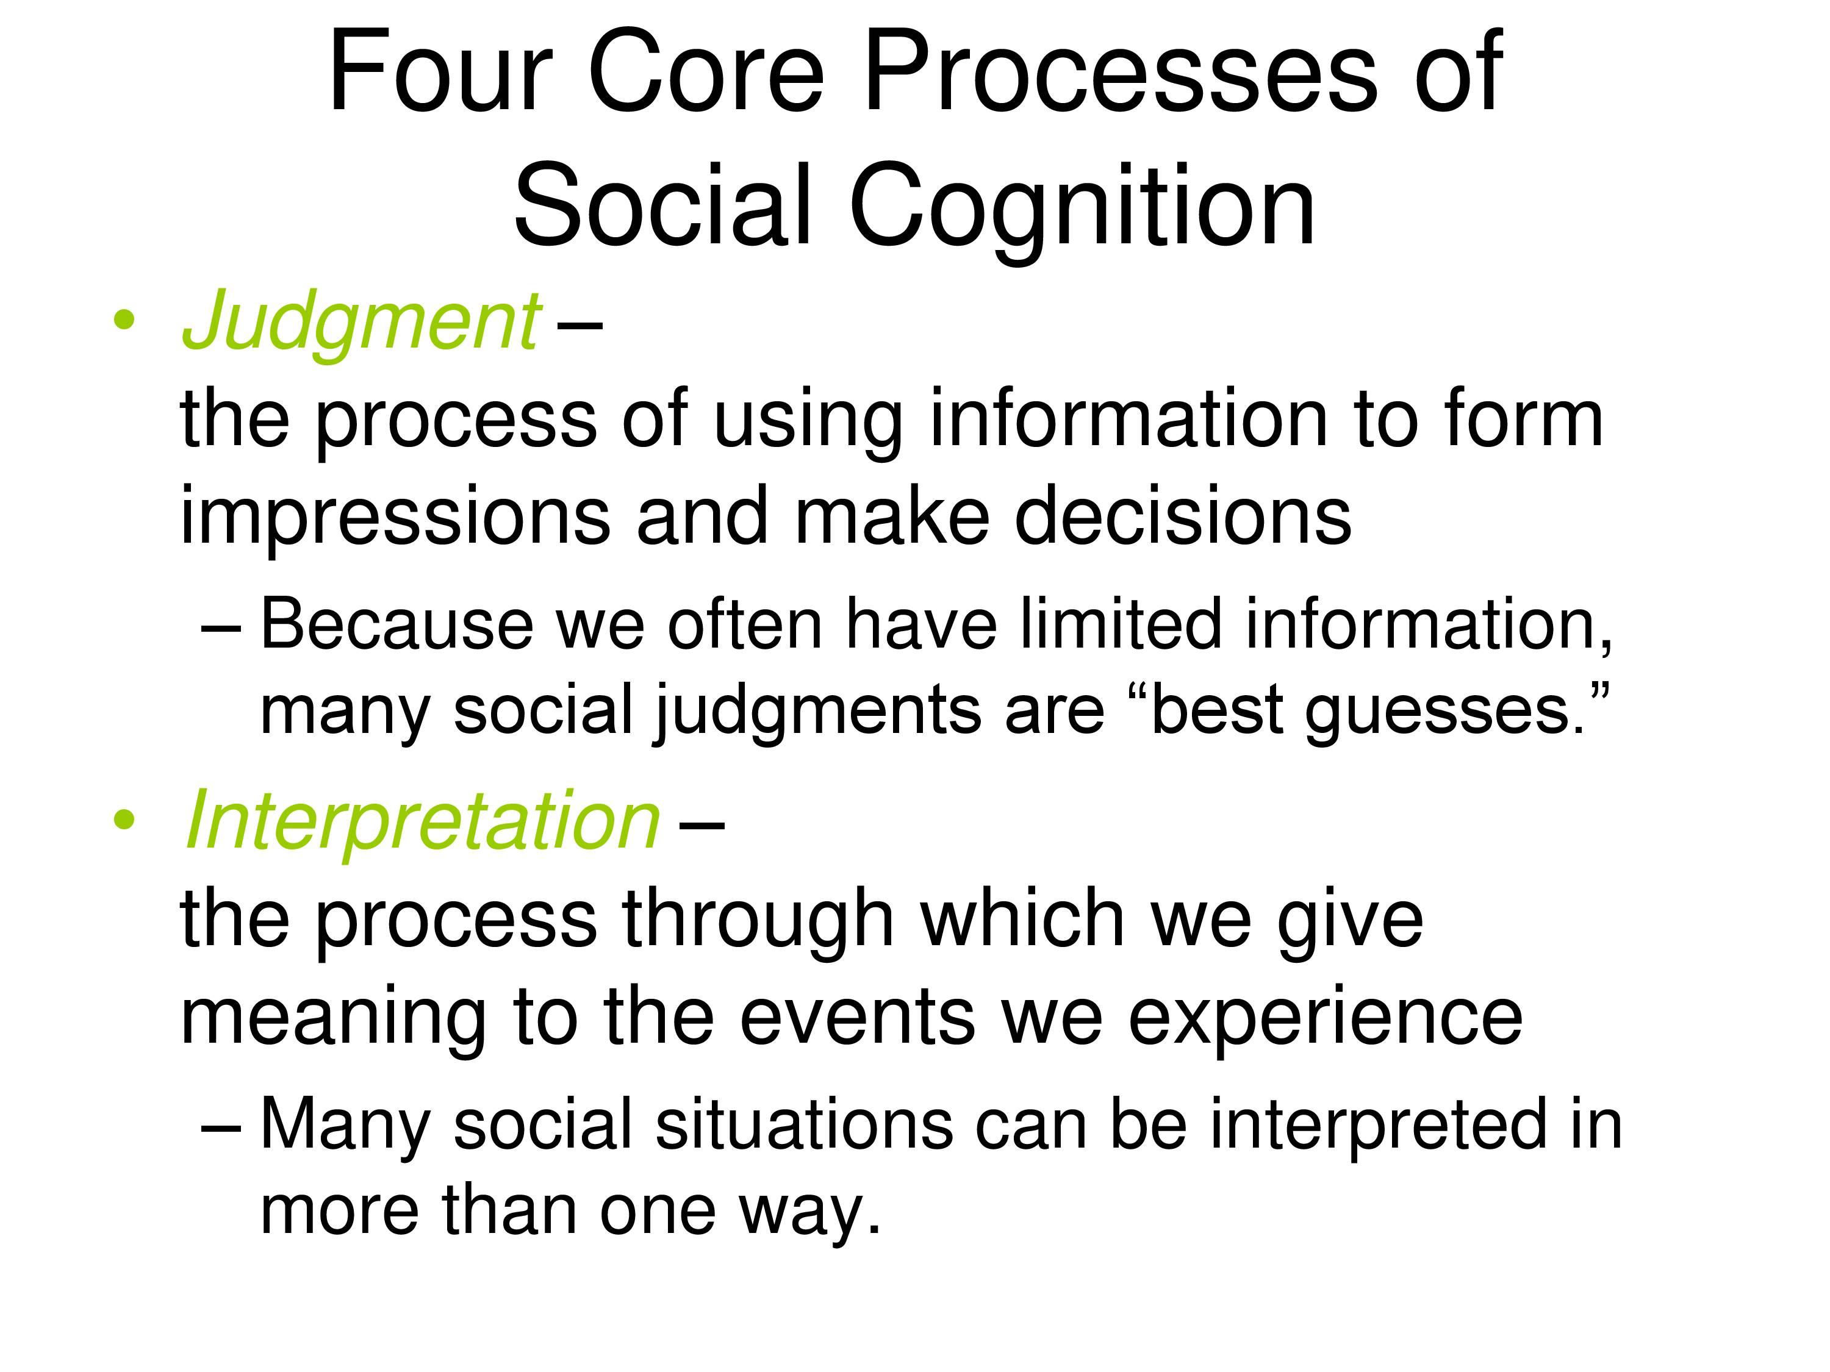

Slide 12
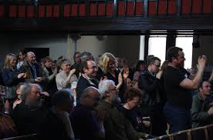
The Standing Ovation
When people on the front seats start rising, do others behind them follow suit?
Unless you really don’t like the speech made, would you also stand up?
What happens in a theatre when watching a movie, do you notice conformity there?

Slide 13
Differences in conformity, compliance, obedience, acceptance
Conformity-
A change in behavior or belief as the result of real or imagined group pressure.
When you come to school, are you conforming?
When you eat using a spoon, are you conforming?
Important pointer to answer the above questions- would your behavior or beliefs be the same if you were apart from the group?
Its an alone vs with group situation

Slide 14
Compliance-
Conformity that involves publicly acting in accord with an implied or explicit request while privately disagreeing
Acceptance-
Conformity that involves both acting and behaving in accord with social pressures. There is internal acceptance

Slide 15
Obedience-
Acting in accord with a direct order or command
If compliance is to an explicit command, it becomes obedience
Milgram's experiment

Slide 16
NORMATIVE INFLUENCE INOFRMATIONAL INFLUENCE
NORMATIVE INFLUENCE
Conformity based on a persons desire to fulfill others expectations, often to gain acceptance
INFORMATIONAL INFLUENCE
Conformity occurring when people accept evidence about reality provided by other people
The result of wanting to be liked and be part of a group
The result of wanting to be right and looking to others for the right answer when the situation is ambiguous

Slide 17
Define Attitude?
A favorable or unfavorable evaluative reaction toward something or someone (often rooted in ones belief, and exhibited in ones feelings and intended behavior)
The study of attitudes is a major topic within the field of social psychology.
They represent a very basic component of social cognition.
They often influence behavior, especially when they are strong, accessible, and long-standing.

Slide 18
How do attitudes form then?
So how do you think attitudes form?
-SOCIAL LEARNING—The process through which people acquire new information, forms of behavior, or attitudes from other persons (this is the major source)
Three learning processes are important to the development of attitudes
1)Classical Conditioning—learning in which one stimulus becomes a signal for the presentation of another stimulus (learning by association)
2)Instrumental/Operant Conditioning—learning in which responses (e.g., attitudes) that lead to positive outcomes or which avoid negative outcomes are strengthened
3) Observational Learning—learning in which individuals acquire new forms of behavior (e.g., attitudes) as a result of observing others
----Social Comparison to people that are liked also plays a role in learning attitudes from others and people learn attitudes from those they like and respect

Slide 19
Do we know ourselves well?
Do you think there might be times when what you say (Consciously) might be different from how things actually might be?
Our rational logical explanation may omit our unconscious attitudes
Eg, hermaphrodite

Slide 20
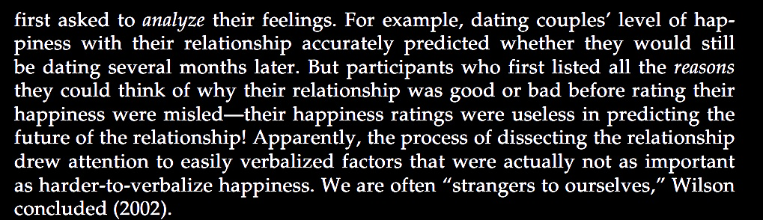
So does your attitude successfully predict behavior?
Not always actually. Read the following example

Slide 21
Link Between Attitudes and Behavior
Even though attitudes do not always successfully predict behaviors, nonetheless, there does exist a very strong relationship between the two
Role of the Social Context- Attitudes and behaviors diverge a lot of the times, because of the situation presented to us
LaPiere (1934) – travelled for 2 years in the US with a Chinese couple. Went to 184 restaurants and 66 hotels and motels and were treated nicely. When LaPiere wrote to them asking if they would serve Chinese visitors again, 92% restaurants and 91% hotels refused
Attitudes predicting behaviors is not linear. People often give into situational pressures

Slide 22
RECONSTRUCTING OUR PAST ATTITUDES
Up till now we have seen what attitudes are, cultural impact on attitudes, the implicit and explicit attitudes. But do our long held attitudes change?
People whose attitudes have changed often insist that they have always felt much as they now feel
Daryl Bem and Keith McConnell (1970) conducted a survey among Carnegie Mellon University students. Buried in it was a question concerning student control over the university curriculum
A week later, the students agreed to write an essay opposing student control. After doing so, their attitudes shifted toward greater opposition to student control. When asked to recall how they had answered the question before writing the essay, the students “remembered” holding the opinion that they now held and denied that the experiment had affected them

Slide 23
Rosy Retrospection
Besides the long held attitudes that we just spoke about, do we change the attitude towards memories?
Think about the last time you went out with your friends, to a big fun get together. How was it?
Terence Mitchell, Leigh Thompson, and colleagues (1994, 1997): recall mildly pleasant events more favorably than they experienced them
Likely to minimize the boring and unpleasant aspects and remember the high points
Its not that we are totally unaware of how we used to feel, just that when memories are hazy, current feelings guide our recall

Slide 24
Cathy McFarland and Michael Ross (1985) found that as our relationships change, we also revise our recollections of other people. They had university students rate their steady dating partners. Two months later, they rated them again.
Students who were more in love than ever had a tendency to overestimate their first impressions—it was “love at first sight.” Those who had broken up were more likely to underestimate their earlier liking—recalling the partner as somewhat selfish and bad-tempered.
What does this tell you about rosy retrospection?

Slide 25
PREJUDICE, DISCRIMINATION & STEREOTYPING
What do you understand by these terms?
Do they overlap?

Slide 26
Stereotype
A belief about the personal attributes of a group of people. Stereotypes are sometimes overgeneralized, inaccurate, and resistant to new information (and sometimes accurate). They may be positive or negative but they impact how social information is processed.

Slide 27
Prejudice
A preconceived negative judgment of a group and its individual members, an irrational attitude based on group membership.

Slide 28
How would you define gender stereotypes?
Can it be both positive and negative?
When does this become a prejudice?

Slide 29

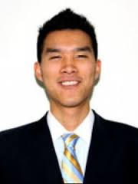
A
Q. Person A meets person B for the first time. Person A says the following, ‘hey, I must say your accent is perfect. You must have practiced a lot. When did you move here from China?’ person B says ‘eh, excuse me. I was born here. I am as American as you are.’
What happened here. Give your reason?
B

Slide 30
Discrimination
Unjustified negative behavior toward a group or its members

Slide 31
Quick Q/A
Jones thinks that physically handicapped people are also intellectually disabled-
Stereotype
Jones meets a girl and thinks to himself “This girl has polio and there are high chances she might also have mild intellectual deficit”-
Prejudice
Jones meets the mother and asks her “I notice she has polio, does your daughter have mild intellectual deficit also”-
Prejudice
The girl is seated next to Jones, he starts to feel uncomfortable and leaves his seat to sit else where-
Discrimination

Slide 32
Examples from the book-
1. RELIGION
Muslims not hired / paid well by managers (Park et al, 2009). What is this?
Example of discrimination based on religion
Muslims perceive Westerners as greedy and immoral (Wike & Grim, 2007). What is this?
Stereotype, generalizing Westerners as greedy

Slide 33
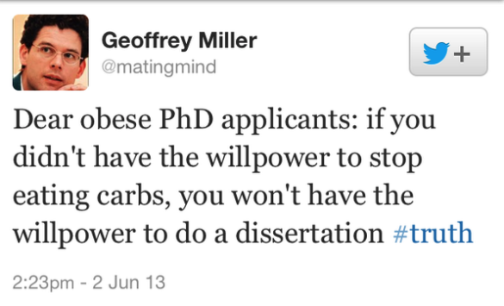
2. WEIGHT
Overweight people marry less often, gain entry to less-desirable jobs, and make less money (Swami & others, 2008).
Weight discrimination, exceeds racial or gender discrimination and occurs at every employment stage—hiring, placement, promotion, compensation, discipline, and discharge (Roehling,2000)
More often bullied, and as adults, they are more often depressed

Slide 34
DEFINITION OF STEREOTYPE:
They are beliefs, not prejudice. Stereotypes may support prejudice, yet one might believe, without prejudice that men and women are different yet equal
Stereotype should be seen as the picture that comes to mind when one thinks about a certain group
Certain examples given in the book include
Professors are absent minded
Americans are outgoing
Pakistanis are…?

Slide 35
‘Politician are all crooks, but our senator Jones is a good guy’. This is?
A stereotype without prejudice towards an individual
A group of black kids walk into a shop. The owner was watching a show on his laptop, but paused the episode to keep a closer eye on the kids in his store.
Discrimination
Asim, being an exchange student from Pakistan, was thought to be good at mathematics because he was from an Asian country.
Prejudice

Slide 36
Social Psychology Principles at Work

Slide 37
Social Facilitation
Social facilitation refers to presence of people increasing an individual’s "dominant" responses (i.e., easy or well-learned behaviors).
If the dominant response is to perform correctly, then performance improves when others are present.
If the dominant response is to perform incorrectly (e.g., a difficult task or learning something new), then performance worsens when others are present.

Slide 38
Group Dynamics
Group dynamics refers to inﬂuences of groups on individual members’ behavior and cognitions more broadly than social facilitation per se.
Groups are particularly inﬂuential on individuals who consider themselves to be members of the group or who feel compelled to align with the group.

Slide 39
Informal Social Communication
Informal social communication holds that unplanned interactions and communication with other people inﬂuences opinions, attitudes, beliefs, and behaviors and that "functional distance" (i.e., interactions with other) is more important that "physical distance" (the actual amount of geometric space)

Slide 40
De-individuation and Individuation
De-individuation refers to the psychological "need" to be part of a group, whereas Individuation refers to the psychological "need" to be singled out and recognized.

Slide 41
Social Comparison
According to Social Comparison Theory, people have a need to judge the "goodness" of their behaviors and cognitions.
In the absence of physical realities or clear indications of correctness, people rely upon comparisons to similar people and upon the behaviors and opinions of people whom they admire.

Slide 42
Conformity
Conformity refers to the tendency of individuals to adopt beliefs and behaviors of other people with whom they interact.
Conformity is most likely when there is little diversity of perspectives, opinions, and behaviors, and when it is not psychologically "safe" to not conform.

Slide 43
Aﬃliation
The principle of Aﬃliation holds that people prefer to be with other people, especially with others perceived to be similar or in similar situations.

Slide 44
Persuasive Communication and Attitude Formation
There are speciﬁc communication strategies and techniques that are particularly persuasive and which can shape the attitudes of other people.
Background. Social psychologists have a great deal of interest in communication (sending and receiving, verbally and
non-verbally) because it is central to human relationships. Persuasive communication inﬂuences opinions, behaviors, team building, performance, and cohesiveness.
Key principles include: authenticity; clarity; consistent verbal and nonverbal communication; point/counterpoint (; resistance to "counterpropaganda"; recency and primacy of messaging; perceived self-interest; perceived source credibility on communication eﬀectiveness; power of repetition (Weaver et al., 2007).

Slide 45
Cooperation, Competition, and Conﬂict
People interact in ways that may be cooperative, competitive, and/or in conﬂict. Interaction may be positive or negative depending on the situation, the individuals involved, and how the situations and interactions are framed and perceived.
Cooperation involves individuals working interdependently or independently to achieve common or individual goals. Cooperation is usually considered to be positive.
Cooperation can be negative when individuals make or perceive they make markedly diﬀerent contributions.
Competition involves individuals working to achieve similar goals wherein only one or a few succeed.

Slide 46
Competition is considered to be negative if there are clear losers who suﬀer psychologically and/or physically. Competition is positive if it motivates individuals to optimize development and performance.
Conﬂict is usually a negative situation when it involves winner(s) versus loser(s) and the consequences are serious. Conﬂict is positive and valuable when it involves expression of contrasting views to solve a problem.

Slide 47
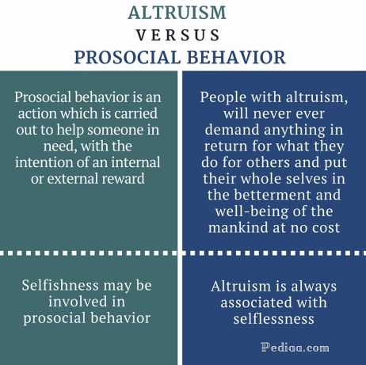

Slide 48
Pro-social Behavior at Work
Resource control theory states that pro-sociality as well as anti-sociality are basic patterns of resource control in human psychological and social functioning (Hawley, 1999).
For example, employees need various types of resources (e.g., informational, material, and social) to carry out their tasks in an organization.
Interpersonal relations are a source of access to important resources including goal support, know-how and know-who (Ciarrochi et al., 2019).
In this sense, friendships on the job should be seen as a resource that individuals strive to develop and maintain (Ciarrochi et al., 2019).
It has been argued that good cooperators work better and last longer on the job than poor cooperators (Wilson et al., 2014). Recently, Ciarrochi et al. (2019) suggested that being prosocial is perhaps the best path to success.

Slide 49
Organizational Citizenship Behavior
OCB is defined as actions that support the social and psychological environment where task performance unfolds (Bolino and Grant, 2016).
Lee and Allen (2002) noted that these behaviors represent employees’ voluntary actions such as helping coworkers and attending non-obligatory events which facilitate organizational flow although they are not essential components of the task at hand.
OCB across individuals leads to better organizational performance (Choi, 2009).
OCB constitutes actions that are taken with no expectation for recognition or compensation (Koslowsky and Pindek, 2011).

Slide 50
A significant part of the variance in production and performance quality, quality, efficiency and effectiveness can be explained by interpersonal helping, and specifically OCB (e.g., Organ, 1988; Organ et al., 2006; Podsakoff et al., 2009).
OCBs provide social facilitation and reduce social friction by enabling group members to focus on their task more than on interpersonal relationships (Organ, 1988) or conflicts and increase individual performance efficiencies (e.g., Smith et al., 1983; Borman and Motowidlo, 1997).
OCBs can also enhance individuals’ performance by building coordination skills (e.g., Smith et al., 1983).
Podsakoff et al. (2000) suggested that OCB can contribute to organizational performance by enhancing coworkers’ and managers’ productivity by facilitating collaboration between work groups and enabling the organization to adapt to environmental changes.
Lam et al. (2016) found that engaging in OCB behaviors enhances employees’ vitality, which contributes to the enhancement of employees’ resources leading to better well-being.

Slide 51
LEADERSHIP STYLEs
1. Democratic Leadership
This is as clear as its name. In democratic leadership, the leaders make or break decisions democratically, based on their team’s opinion and feedback. Although it is the leader who makes the final call, every opinion counts. This is easily one of the most effective leadership styles since it allows employees to have a voice.
2. Autocratic Leadership
This is exactly the opposite of democratic leadership wherein the opinions of employees are not considered. Leaders with this style expect others to adhere to the decisions they take, which is not a sustainable approach in the long term.
3. Laissez-faire Leadership
Laissez-fire means “let them do”. This style is the least intrusive and leaders with this approach ensure that the authority lies with the employees. While this leadership style can empower, it may also limit development, therefore, must be kept in check.

Slide 52
4. Transformational Leadership
This kind of leadership always aims at transforming and improving functions and capabilities. There may be tasks and schedules assigned and leaders following this style may ask employees to push their boundaries constantly. Most growth-minded companies tend to adopt this kind of a leadership style.
5. Transactional Leadership
This is a very common leadership style today based on the action-and-reward concept. For instance, an employee or team may receive an incentive or bonus for achieving a target set by the company.
6. Coach-Style Leadership
This leadership style focuses on larger growth while encouraging individual team members to focus on their strengths and talent. Though this is similar to strategic and democratic leadership styles, the focus here is more on the individual.
7. Bureaucratic Leadership
This kind of leadership style goes by the books. Although leaders with this approach do listen to employees and their opinions, they may negate or reject it, in case they go against the company’s ethos or policy.

Slide 53
Leadership type affecting group behavior
Honesty and integrity, Empathy
Resilience, Emotional Intelligence
Humility, Transparency
Visions and Purpose
Confidence, Inspire Others
Commitments and Passions
Good Communicator
Decision-making Capabilities
Accountability
Delegations and Empowerment
Creativity and Innovation

